Slide 1
Analysis of restaurants in Bangalore
To get insight into the restaurant business in Bangalore and to help new entrepreneurs decision making.

Slide 2
Introduction
Bangalore is the capital city of Karnataka, India. One of the densely populated cities in India, there is huge opportunity for restaurants. But opening a restaurants needs a lot of planning. It is finally the customer who sustain the business. hence analysis of an existing data can bring out many factors, such as what item is popular in a locality, average price for food, etc.
Following are few considerations to be taken into account while opening a restaurant .
Ideal location - based on density of population and type.
Type of restaurant – North Indian, south Indian, Chinese, Café, bakery, etc
Target customers - richness, if they are ready to pay more
Competition - existing business and their performance parameters
Operating hours - what time or day of the week the people visit restaurants most often?
Size of restaurant - It should be small restaurant of few tables or large one?
Uniqueness - what makes the difference from other restaurants?
Apart from these there are several things like finance, policies, legal aspects.

Slide 3
The business problem
Let us try to address the following questions
Which is the ideal location in Bangalore for a south Indian restaurant?
What is the menu should be included? What price should be fixed for items?
Who are the biggest competitors?
What should be the seating capacity? How big should be restaurant?

Slide 4
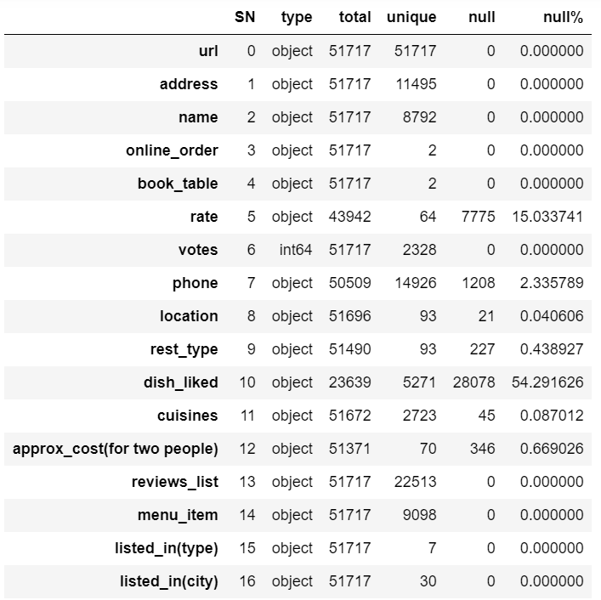
Data
In this analysis I will use the data provided by Zomato published on the Kaggle website. Following information can be obtained from the CSV file
Name, address, url, phone
Location, Type [ 2 sets found]
Rating, Votes
Cost for two
Online table booking and ordering facilities
Cuisines, dishes liked
Data: Kaggle Zomato data Bangalore

Slide 5
Data
Several fields in the data are incomplete. We will analyse with the best of data available. Further the dataset may not cover all the restaurants in Bangalore, few many not have registered on Zomato.
Data Wrangling: Rename few columns, delete the non-important columns, Format the data.
There is no coordinate data available in CSV. However we will fetch it using geopy
We will import the folium leaflet maps to create informative visualisations in the maps

Slide 6
Methodology
Before starting a restaurant one has to understand the existing scenario of the business in the city. For example the restaurants in Toronto will be very different from Bangalore in several aspects. Hence first we use an exploratory data analysis
Once various aspects are understood, we will make a depth analysis of feasibility of a south Indian restaurant and come up with suitable location, menu and other options.

